Slide 1

PPC Monitoring Refresher
April, 2025

Slide 2
Agenda:
Welcome
Integrated Monitoring Platform (IMP)/TerraMatch
Monitoring Timelines
  Latest updates and what to expect in 2025
Tree Monitoring in Year 2.5
  Including monitoring of assisted natural regeneration
Socioeconomics
  Workdays and socioeconomic restoration partners
Discussion

Slide 3
The Integrated Monitoring Platform (IMP)/Terramatch
Latest Improvements
What to Expect in 2025

Slide 4
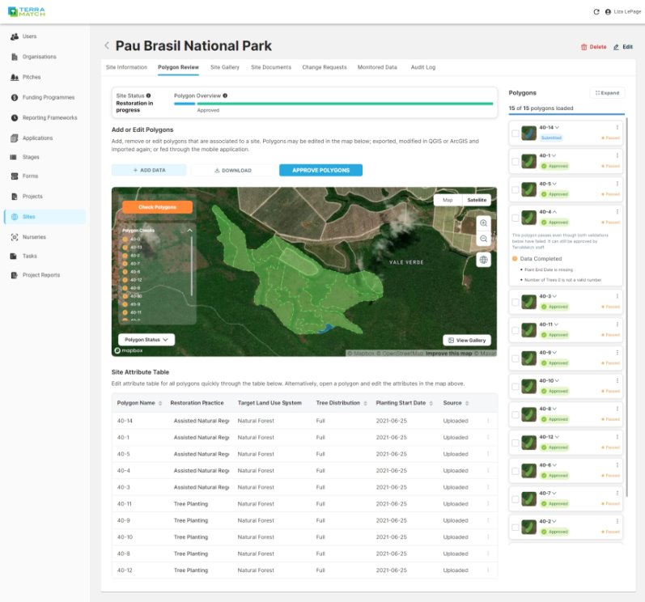
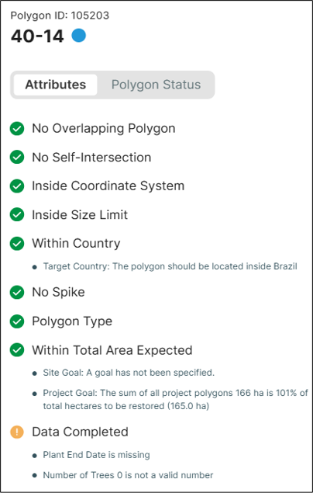
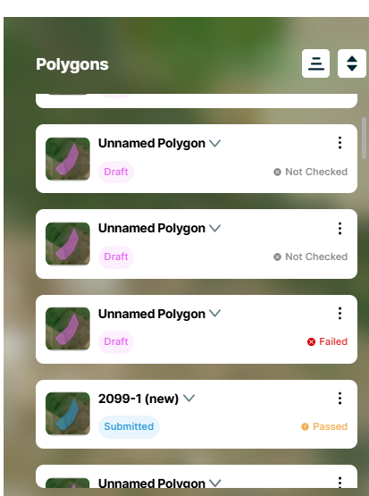
Polygon Collection & Validation (2024 Updates)
Admin view
Add polygons via upload or draw on map
"Check polygons" runs polygons through 9 different tests
Each polygon has a status, represented by a different color
Communicate with your Project Manager/Global Lead through the QA process; comments saved in Audit Log for each polygon
Versioning captures edits to the polygon over time
Project developer view

Slide 5
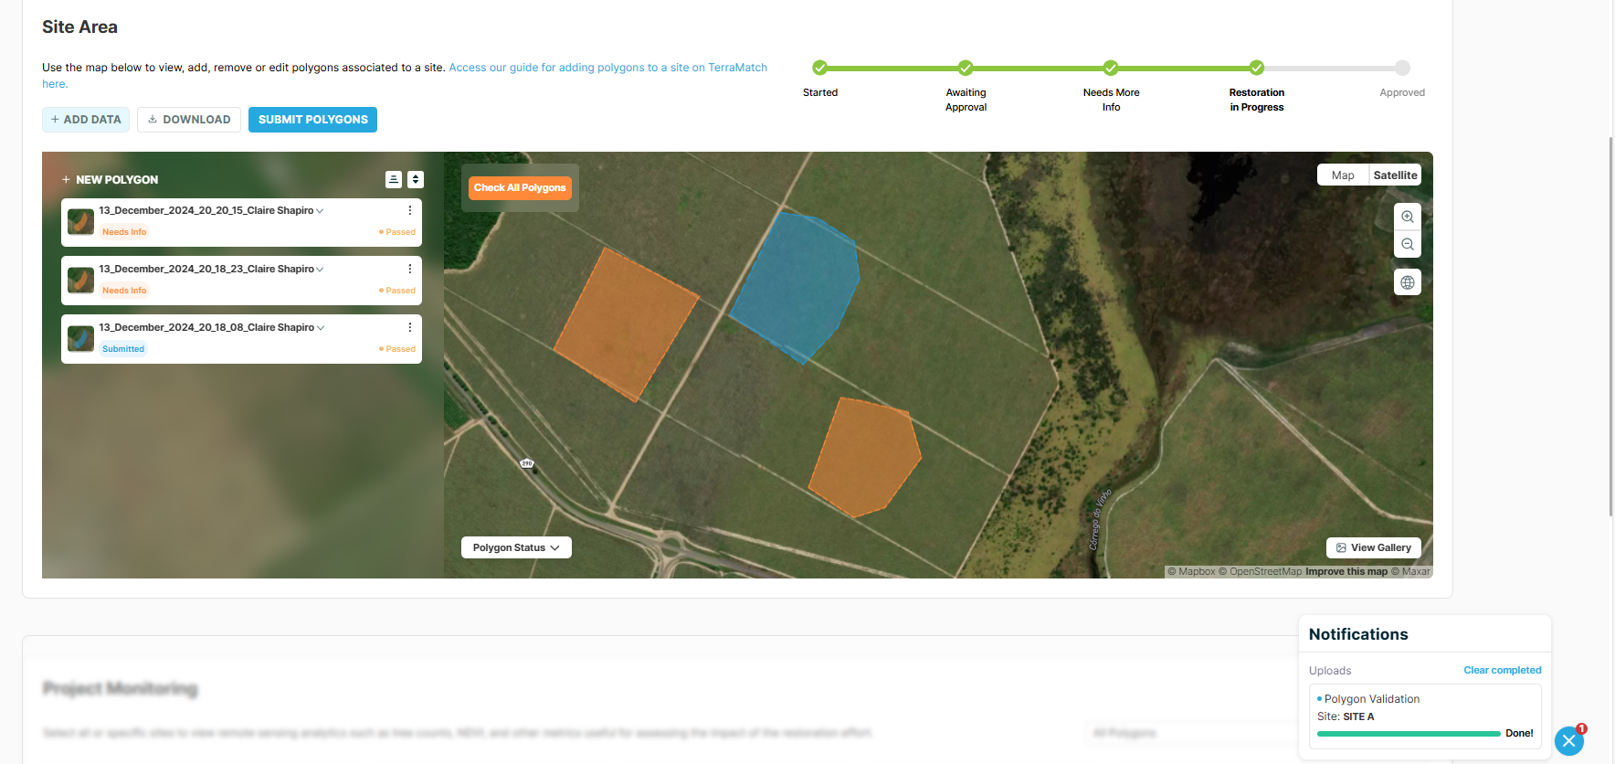
Polygon Collection & Validation Updates
Site page - "Check polygons" runs polygons through 9 different tests
Notification model for polygon upload and validation checks/fixes
Clearer error messaging for polygons that can't be uploaded
Sending weekly polygon emails with any updates on geometry or status for any polygons in your project

Slide 6
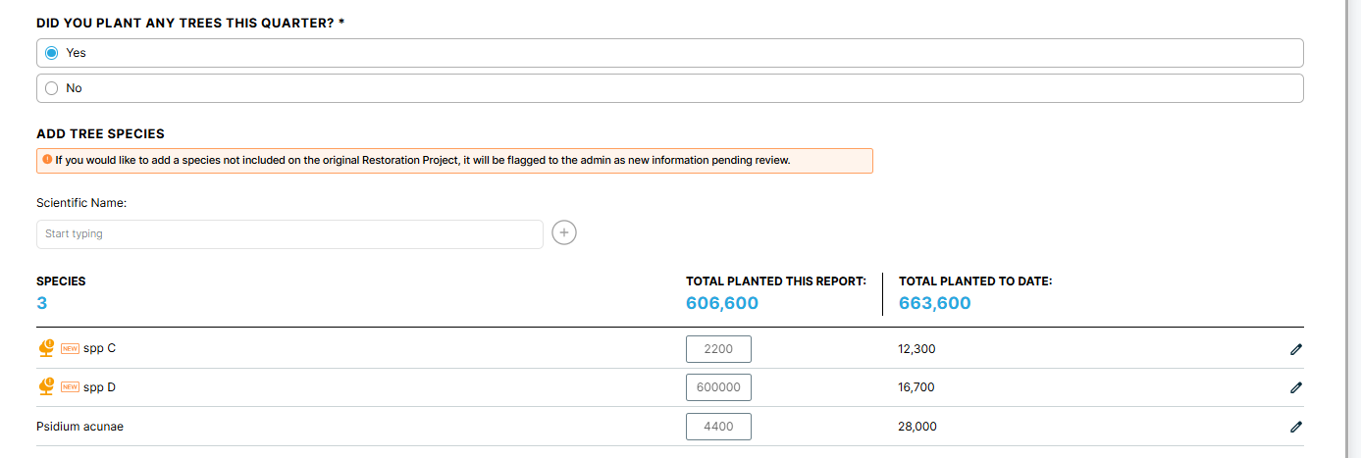
Species Updates
Added taxonomic backbone in late 2024; standardizing species data to better understand progress and impact across PPC portfolio
New species interface for establishment and reporting

Slide 7
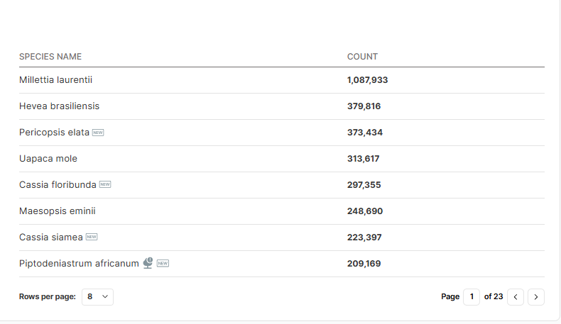
Species Labels
To help with QA and matching species to our database, we've added labels for species added outside of establishment, and non-scientific names

Slide 8
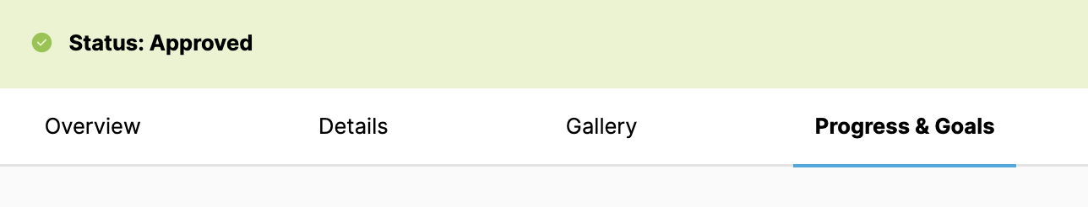
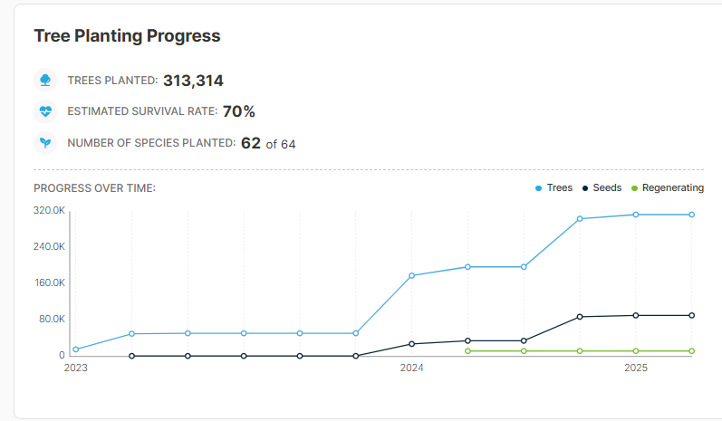
Progress & Goals Graphs
We've updated the "Progress & Goals" tab on project and site pages to visually represent restoration progress over the project's lifecycle

Slide 9
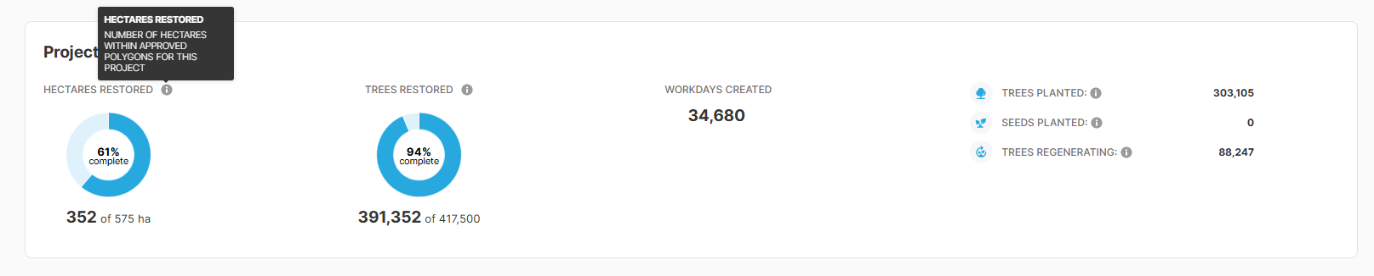
Info Icons on Hectares & Trees Metrics
We've added info buttons with a brief explanation of hectares and trees metrics within "Progress & Goals" sections on project and site pages

Slide 10
IMP – Updates Underway This Year
Bulk upload for workdays, trees planted, and site establishment
Translation updates and improvements for French, Spanish, and Portuguese
Monitoring data available for each project on the platform
Notification + navigation improvements
Workday visualization at project level

Slide 11
Monitoring Timelines
General Review
Shapefiles
Tree monitoring (baseline and year 2.5)

Slide 12
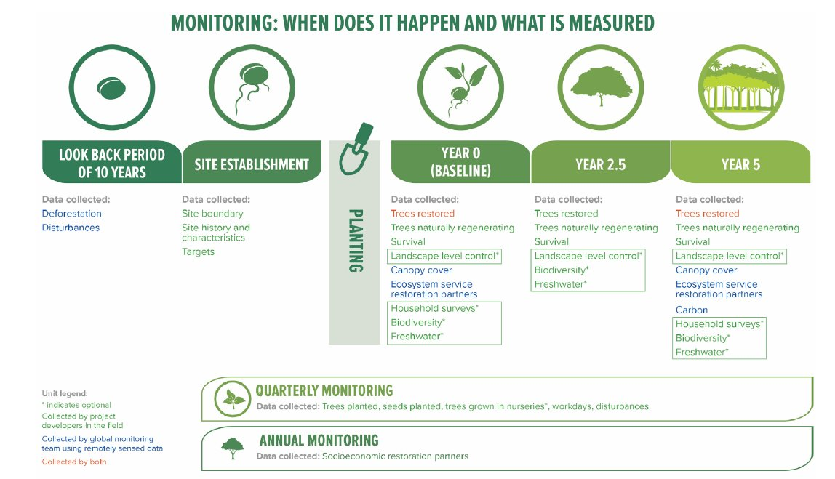

Slide 13
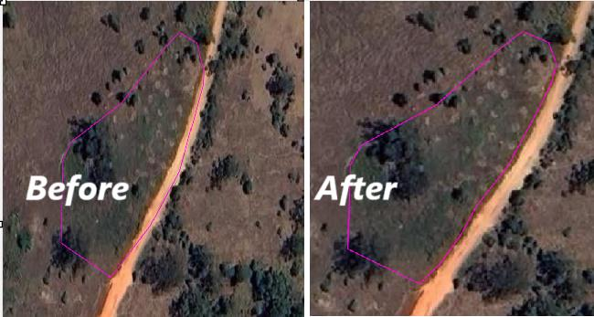
Timeline Reminders - Shapefiles
Final shapefiles must be uploaded to the IMP no later than 6 months after planting
  We should not have changes to site boundaries after this period
    If a site is expanded in the next year or cycle, then a new boundary with the new area can be uploaded
  Important so the global monitoring team can run remote sensing analyses on the correct shapefiles
Total Property
Restored Area
Only the area where restoration is occurring is included in the site

Slide 14
Timeline Reminders – Tree Monitoring Baselines
Baseline tree monitoring should be completed no more than 6 months after planting started on a site
  Requires site level workplans if planting is spread over time
  On very large sites that take a long time to plant, the site can be divided into sections by planting date, and monitoring for each section should occur no later than 6 months after planting started in that section
  Sites that have ANR only (no planting) should be monitored within 6 months of establishment at a maximum
Monitor by section in one Restoration Site
Planted in Jan-Feb
Planted in Mar-Apr
Site 1 - Planted January
Site 1 – Baseline by June
Planted in May-Jun
Site 2 - Planted March
Site 2 – Baseline by September
Site 3 - Planted May
Site 3 – Baseline by November

Slide 15
Timeline Reminders – Tree Monitoring at Year 2.5
Year 2.5 tree monitoring should be completed 30 months after planting started on a site
  Requires site level workplans if planting is spread over time
  On very large sites that took a long time to plant, the site can be divided into sections by planting date, and monitoring for each section should occur based on when planting started in that section
  Sites that have ANR only (no planting) should be monitored 30 months after establishment
Monitor by section in one Restoration Site
Planted in Jan-Feb
Planted in Mar-Apr
Site 1 - Planted January 2024
Site 1 – Y2.5 Monitoring due June 2026
Planted in May-Jun
Site 2 - Planted March 2024
Site 2 – Y2.5 Monitoring due Sept 2026
Site 3 - Planted May 2024
Site 3 – Y2.5 Monitoring Due Nov 2026

Slide 16
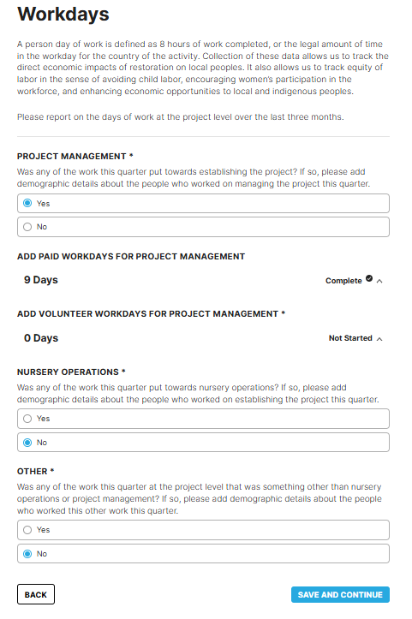
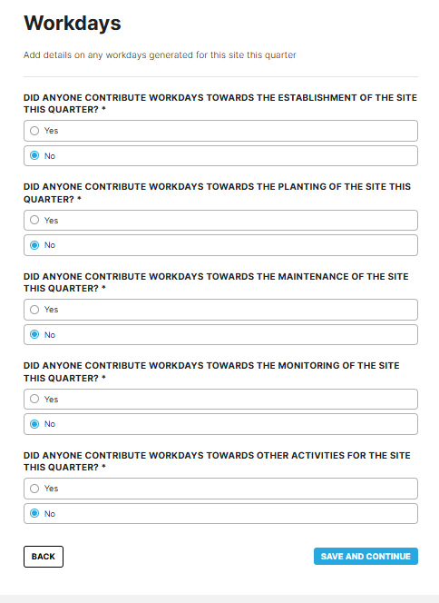
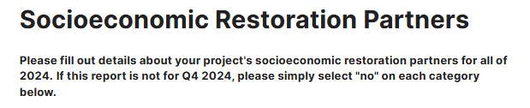
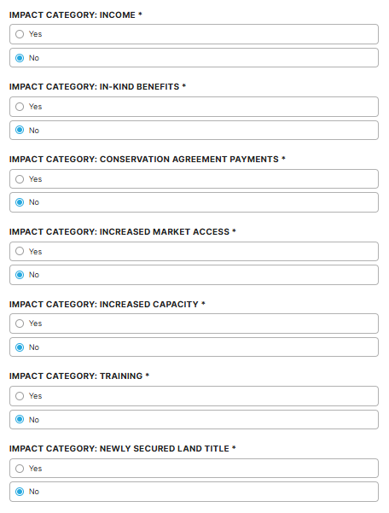
Timeline Reminders – Socioeconomic Data
  Project level Workdays
  Site level Workdays
Workday data
  Uploaded into IMP each quarter covering all work that occurred during the quarter, including planting, maintenance, monitoring, etc
Socioeconomic restoration partners data
  Uploaded into the IMP once a year as part of the quarter 4 reports (due in January). Data is for the whole year

Slide 17
Tree and Seed Planting – Including Infill Planting
Tree and seeding planting data is reported each quarter in the IMP as it occurs
  Divided by site
  Includes scientific names and the count of each species planted
Infill planting (planting that is done to replace dead trees) is reported in the same way, when it occurs
  The tree monitoring cycle does not start the tree monitoring timeline over

Slide 18
Estimating Rates of ANR
Before
2 pieces of information are required to estimate ANR
  Explanation of how you got to the estimated number of trees per HA for ANR and the number of HA with ANR expected. Evidence can include scientific articles, plots established in the field for estimates, and/or previous restoration work in the area.
  Evidence of activities in the field of the “assist” – which includes maintenance of the area, removal of invasive species, fencing, etc.
Now (Starting at Q2/2025)
2 pieces of information are required to estimate ANR
  A conservative estimate of the number of trees expected from ANR per hectare and the number of hectares it applies to. Number calculated from baseline monitoring data (PPC Global Monitoring team)
  Evidence that the 'assist' occurred (Ex: photos showing the installation of fire breaks or fences)
ANR estimates should be conservative because that number is what your project is expected to deliver. Overestimating early can lead to problems later if trees don't regenerate at the expected rate

Slide 19
Tree Monitoring – Year 2.5
Kobo Toolbox Accounts
New Format for Data Corrections
Considerations for Data Collection in Year 2.5
Monitoring Assisted Natural Regeneration
Common Mistakes

Slide 20
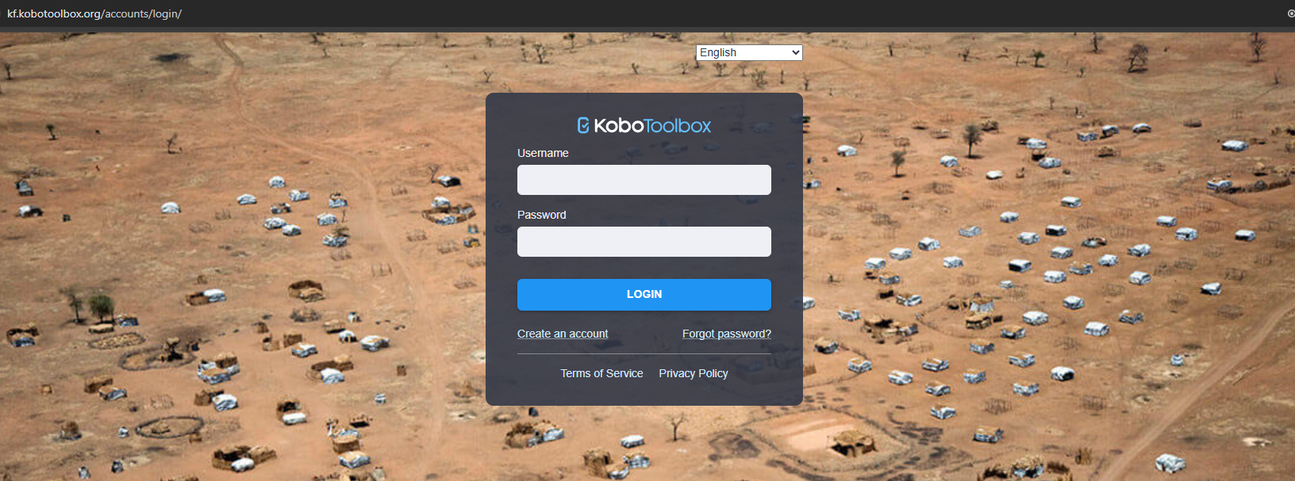
Create Your Own Kobo Account
Allows us to see who is uploading which data and give you access to your data for corrections
https://kf.kobotoolbox.org/accounts/login/
Submit the username created to the CI/WRI Project Manager
Once you have submitted your username, the project manager will set up your account so that you can access the forms you have submitted via KoboCollect.

Slide 21
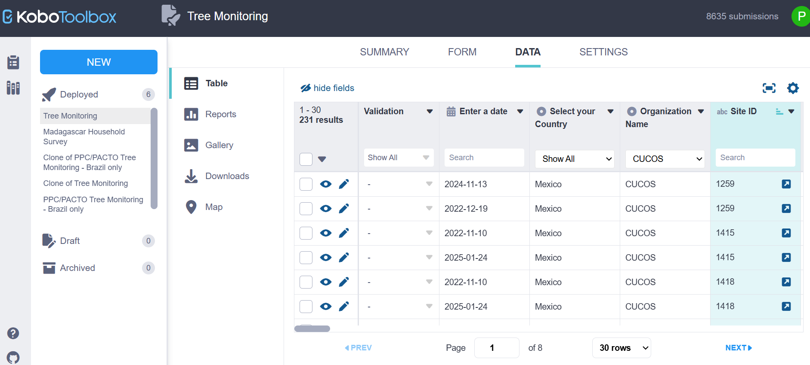
Correcting Your Own Data
Where can I correct the Kobo forms?
  You can still correct directly in the KoboCollect app in the draft version, or
  You can now use the web version directly and correct all the submitted forms

Slide 22
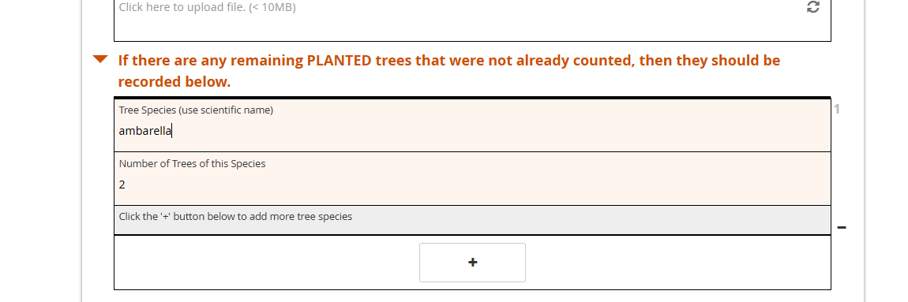
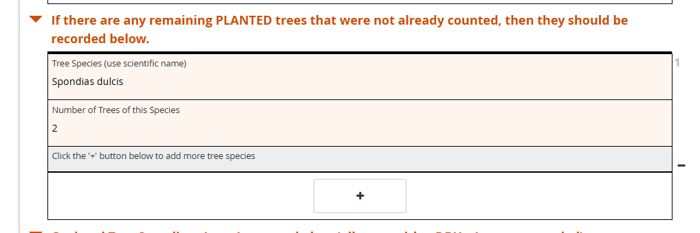
Correcting Your Own Data
When do you need to correct your data?
  When data comes from the field and needs correction (common names to scientific names, for example)
  After your project manager reviews the information and requests correction
    CI/WRI Project manager will submit the list of corrections necessary to be made
    These corrections must be recorded

Slide 23
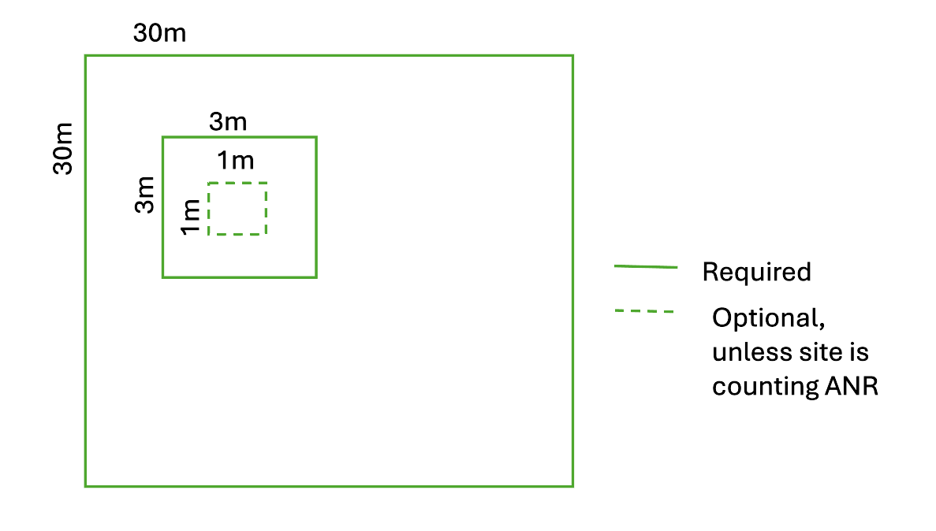
Refresher – Tree Monitoring
30m x 30m plots:
  All trees >10cm DBH (species, type, count)
  All remaining PLANTED trees (species, count)
3m x 3m plots:
  All trees 1 – 9.9cm DBH (species, type, count)
1m x 1m plots:
  All trees <1cm DBH and no DBH (species, type, count)
Now required for sites counting ANR
Sites 'counting ANR' are sites where ANR is one of the practices and ANR estimates are submitted ot the IMP
Gather resources for identifying tree species (apps, plant guides, etc) prior to going into the field

Slide 24
Special Considerations for Year 2.5 Monitoring
Same number of plots as baseline
  Unless exception or update discussed with global monitoring team
Plot ID's of permanent plots must match baseline
Familiarize yourself with baseline data and site characteristics
  Site strata
  Plot characteristics and data from baseline
Permanent plots
  Use GPS points from baseline data collection to navigate back to plots
    Look for markers, account for GPS error
  Collect data within the same plot area
Randomized plots
  For any plots that aren't permanent (up to ½), follow same process for placing plots as baseline (next slide)
Consider marking trees to keep track of which have been counted

Slide 25
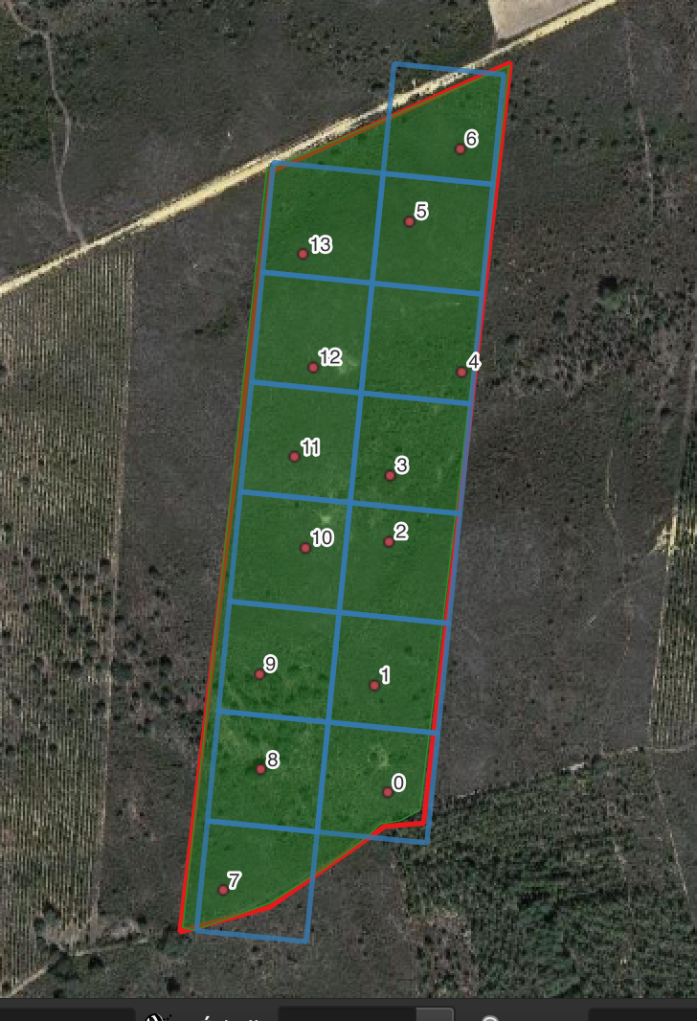
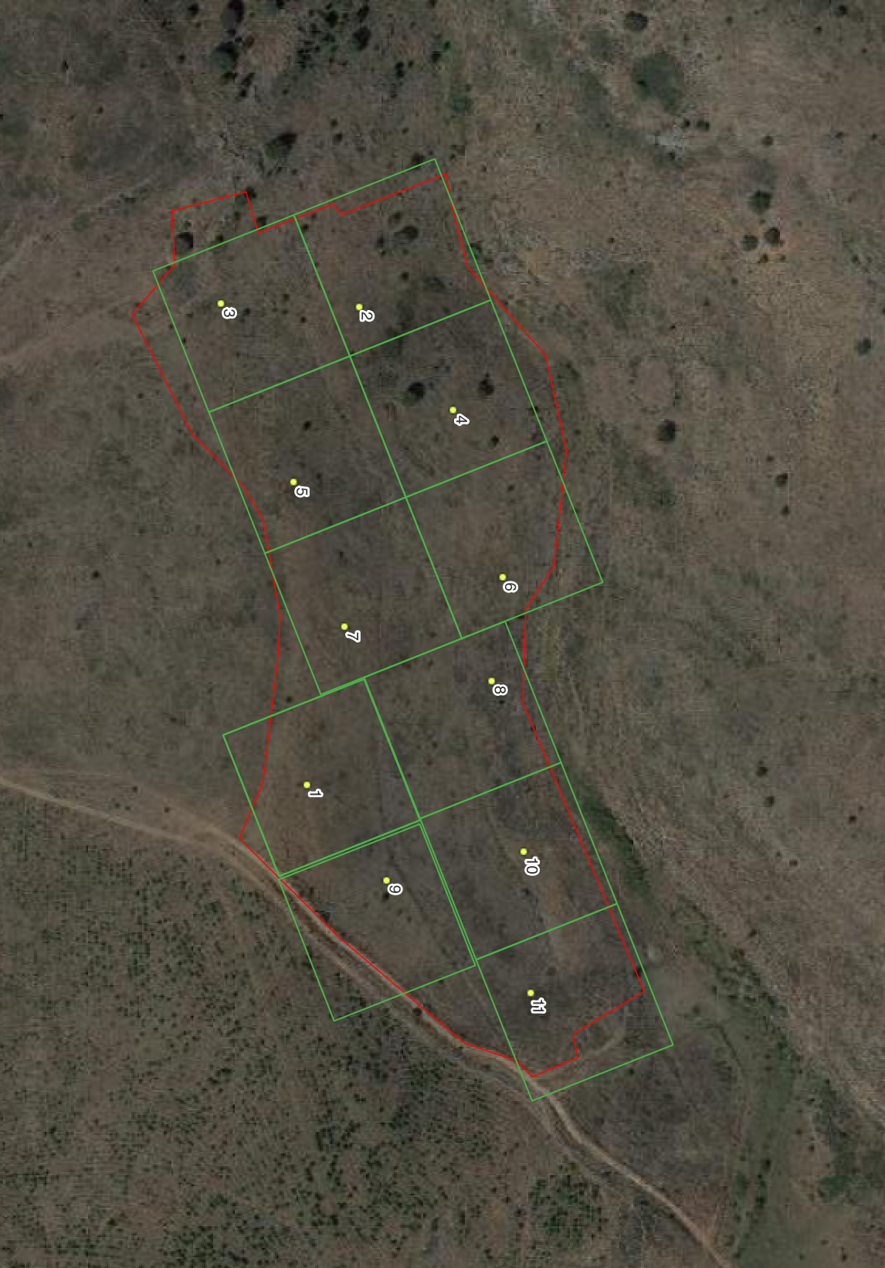
Place plots – generate GPS coordinates
Recommend to place 1HA grids over the site and randomly place a plot within each grid + randomly place control sites (1 per strata):
  Generate randomized "plot centroids" in ArcGIS or using a random number generator to determine where the plot should be placed.
  If necessary, correct the randomized placement distribution to ensure that the right fraction of plots are in each stratum.
Plots should not be placed within 5 meters of the site’s boundary, to avoid edge effects.
Download GPS points to find your plots in the field. Adding the points to a GPS makes it easier to locate the plots.
© CONSERVATION INTERNATIONAL/VEGETATION MONITORING - FRANCE
© CONSERVATION INTERNATIONAL/VEGETATION MONITORING - FRANCE
If in doubt about the proper location of control plots, please contact the global monitoring team. We welcome conversations around proper control design and are available to help determine the right specifications for any given site.

Slide 26
Special Considerations for Monitoring ANR
1m x 1m plots now mandatory in sites counting ANR
  Count all trees smaller than 1cm DBH including trees that have not reached breast height yet (no DBH)
Distinguishing planted trees from naturally regenerating trees
  Naturally regenerating trees might be different species or different sizes from planted trees
  Naturally regenerating trees won't follow the planting pattern

Slide 27
Special Considerations for Areas with Slow Growing Natural Regeneration
1m x 1m plots now mandatory in sites counting ANR
  Count all trees smaller than 1cm DBH including trees that have not reached breast height yet (no DBH)
Typically, a regenerating tree must reach 1cm DBH to be counted towards the PPC target
  If you have sites where regenerating trees are not expected to reach 1cm DBH, speak with the global monitoring team about making an exception
    Only applicable in temperate zones, high elevation zones, or projects planting in aquatic ecosystems

Slide 28
Common Mistakes and How to Correct Them
Notes:
If we have time – Include these slides

Slide 29
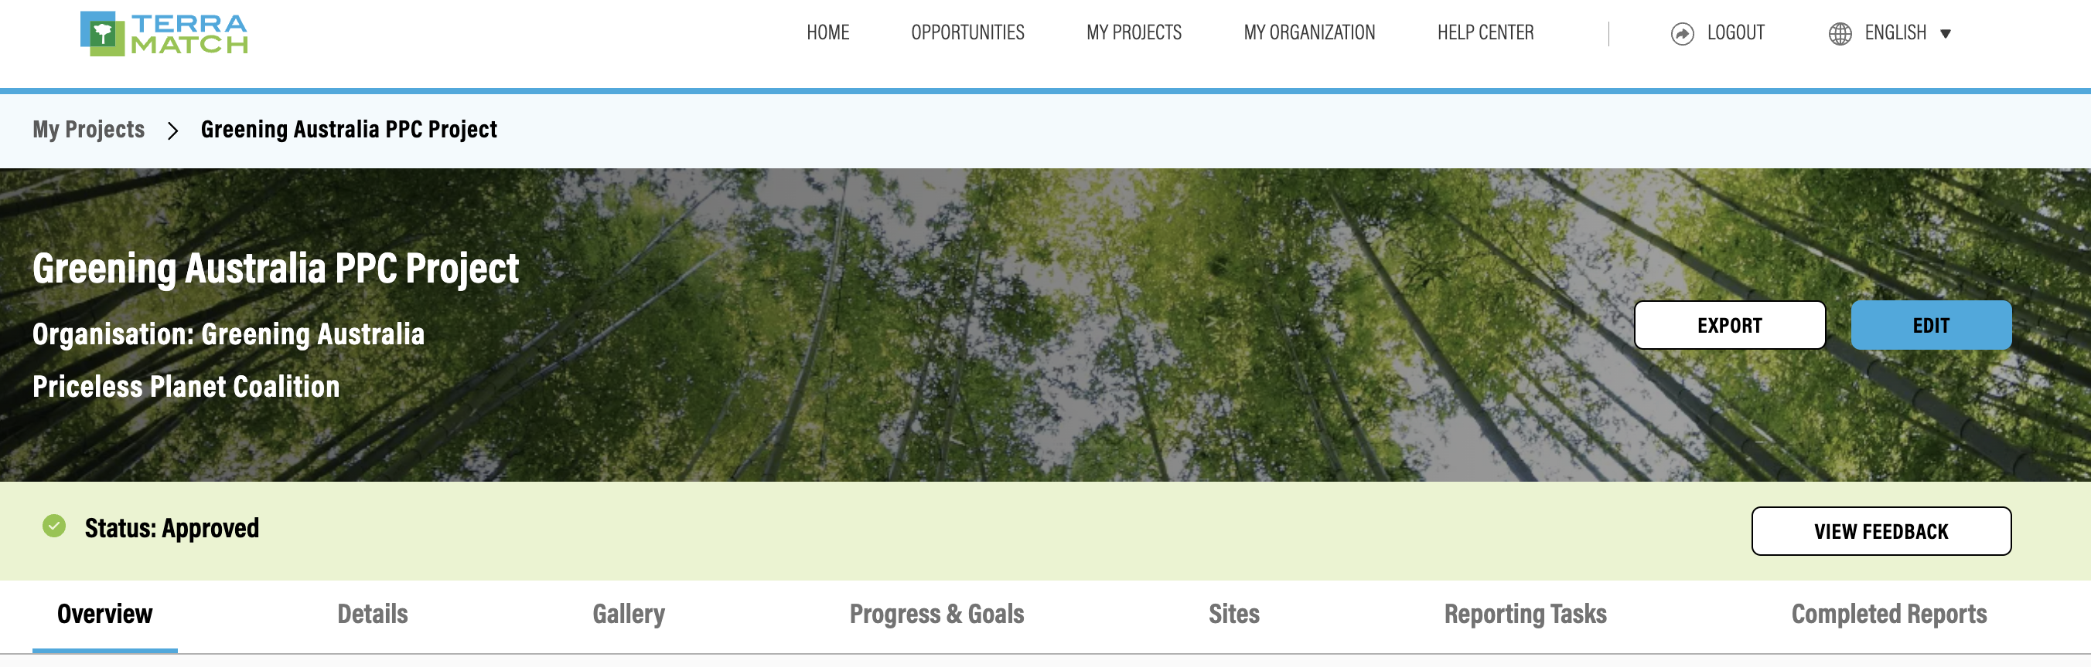
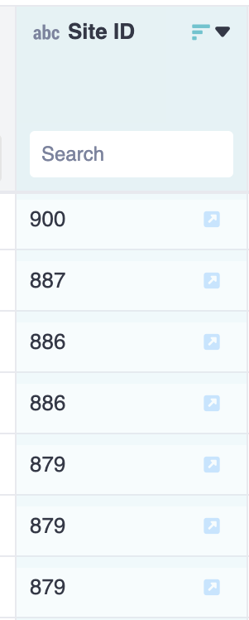
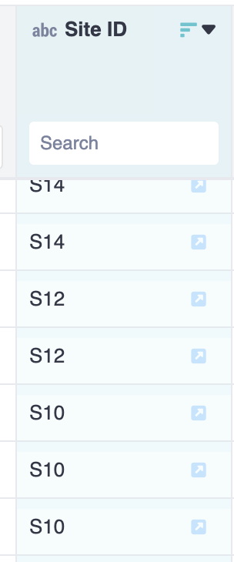
1. Incorrect Site ID
Site ID's don't match the IMP
To find correct Site IDs, export the project from IMP and open the csv. files -->
Good Example
All IDs should be numbers only
Bad Example
Confused with site names (like S0196, A76) which could include letters

Slide 30
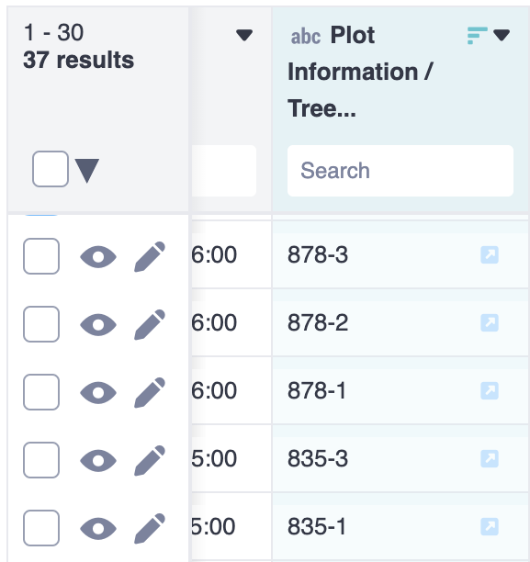
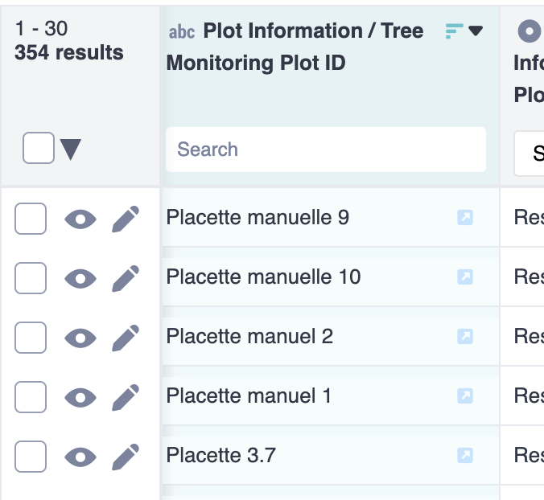
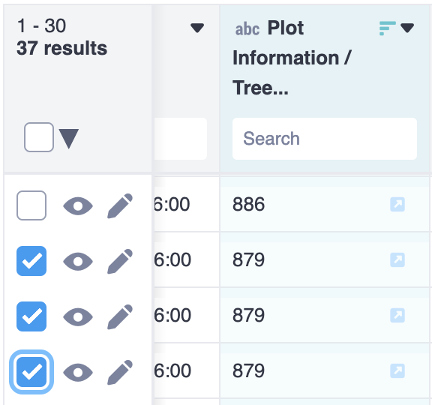
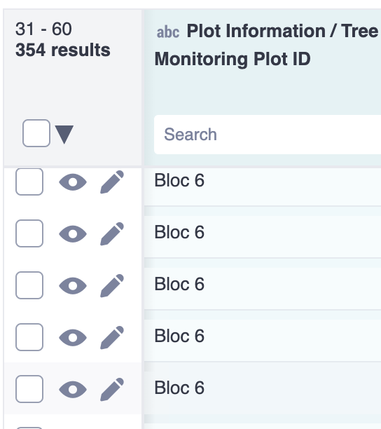
2. Incorrect Plot ID
Plot ID's are duplicated
Good Example
Unique Plot IDs, with different names for suffixes
Bad Example
Duplicated Plot IDs

Slide 31
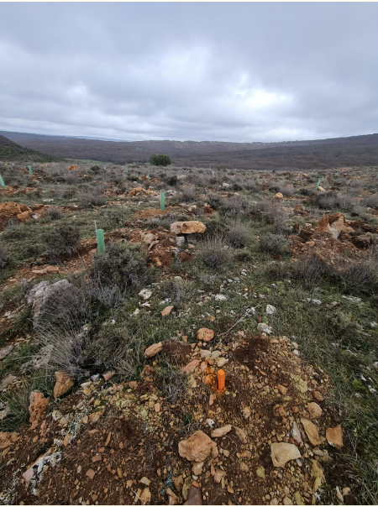
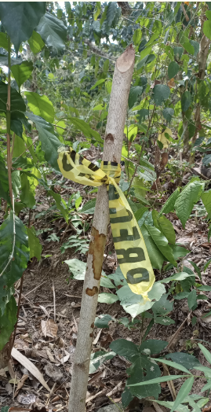
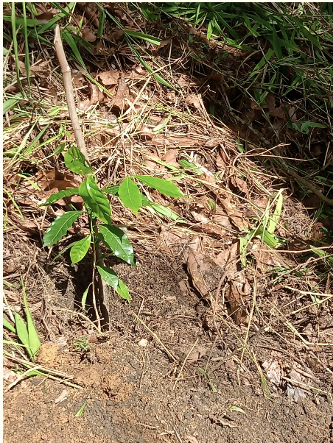
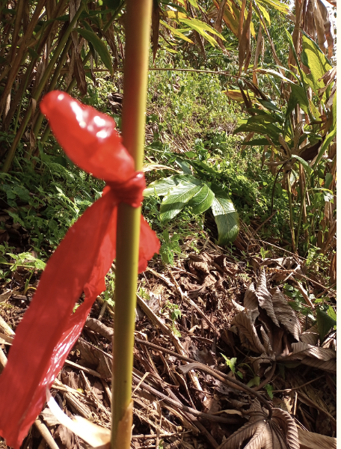
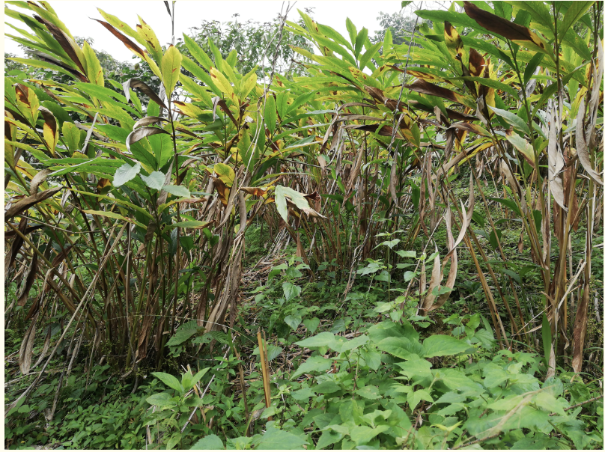
3. Photos not showing enough landscape
Pictures show the corner post or GPS, not looking into the plot
Good Examples
Bad Examples
If tree crowns too dense, ok to show just the trees. But try to include a wide angle

Slide 32
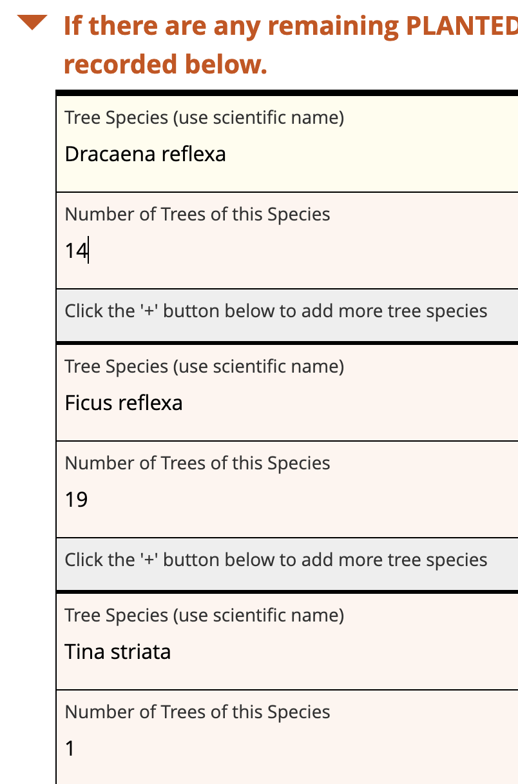
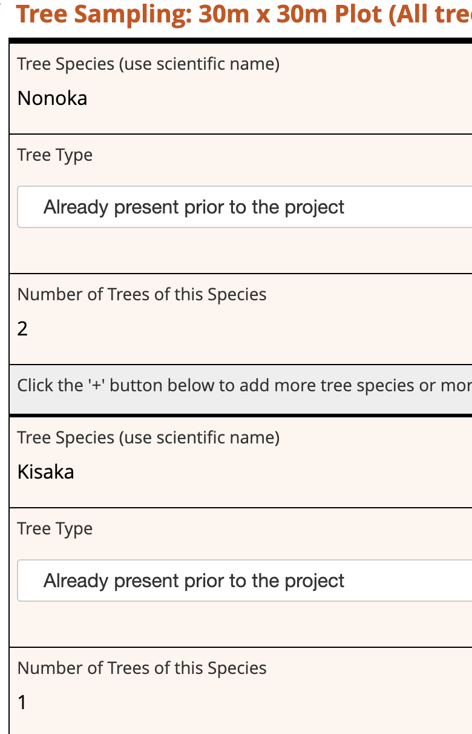
4. Scientific names not used
Common species names are used (should be scientific name)
Good Examples
Scientific names used
Include genus + species names
Bad Examples
Common or local names used

Slide 33
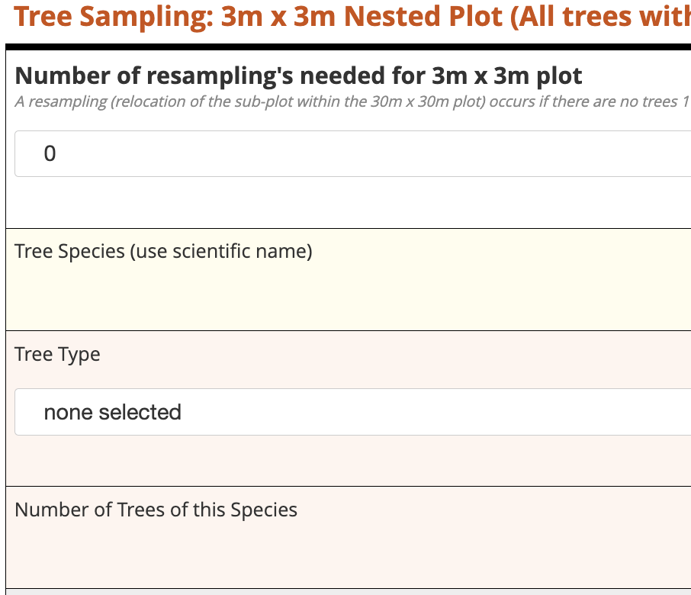
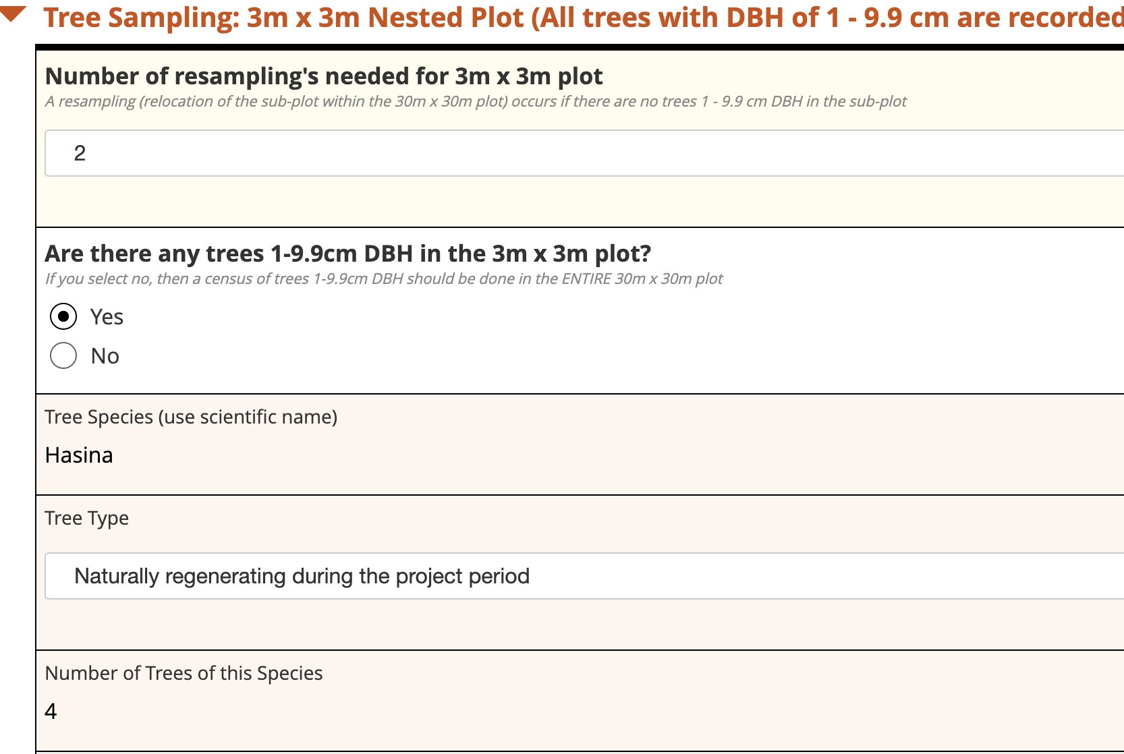
5. No resampling when necessary (3x3m plot)
Resampling does not occur when it should
Good Example
Resample once or twice when no trees were recorded (must NOT be planted trees). If no records after resampling twice, do a census of the 30x30 plot
Bad Example
No resample when no trees were recorded

Slide 34
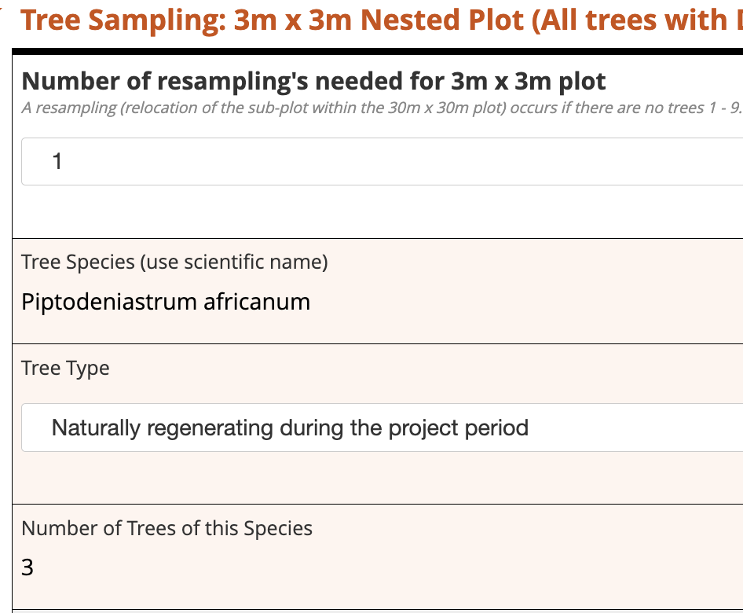
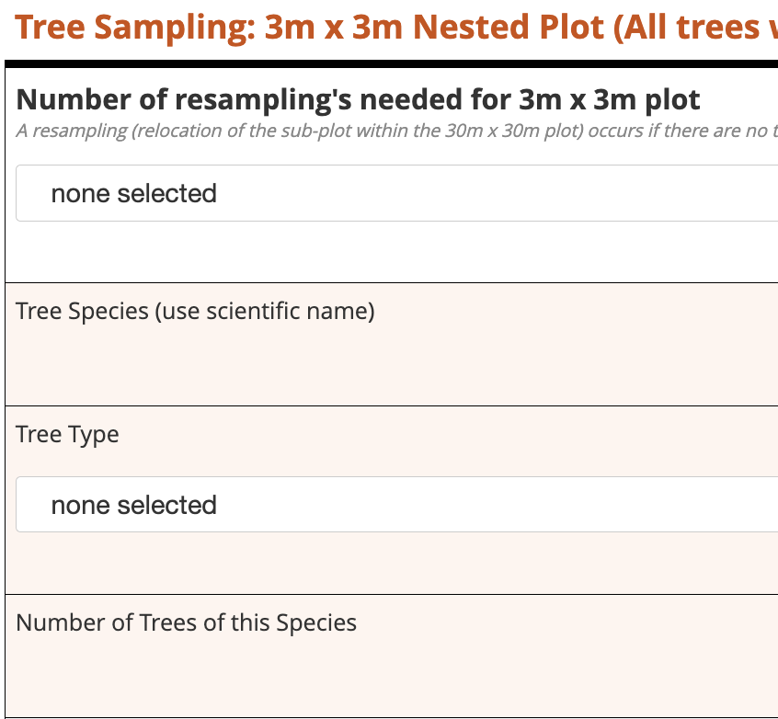
6. Missing tree count/name/type or resampling count
Data in the 3x3 plot is missing
Good Example
All information provided
Bad Example
No records of trees or resampling info

Slide 35
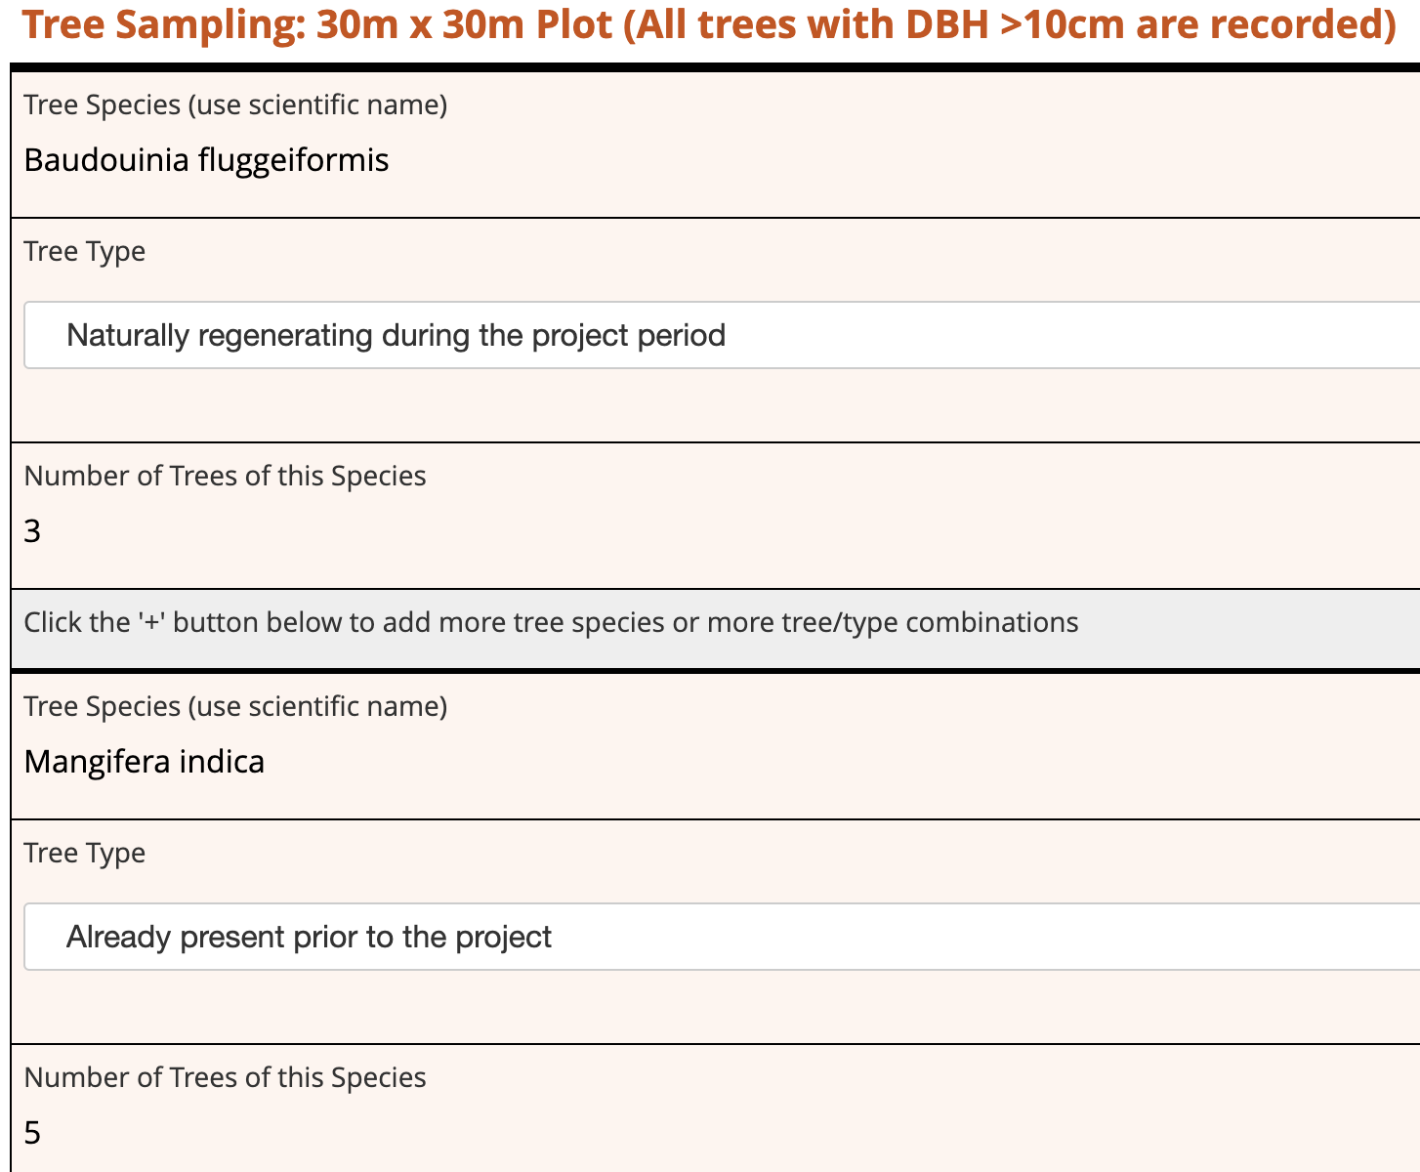
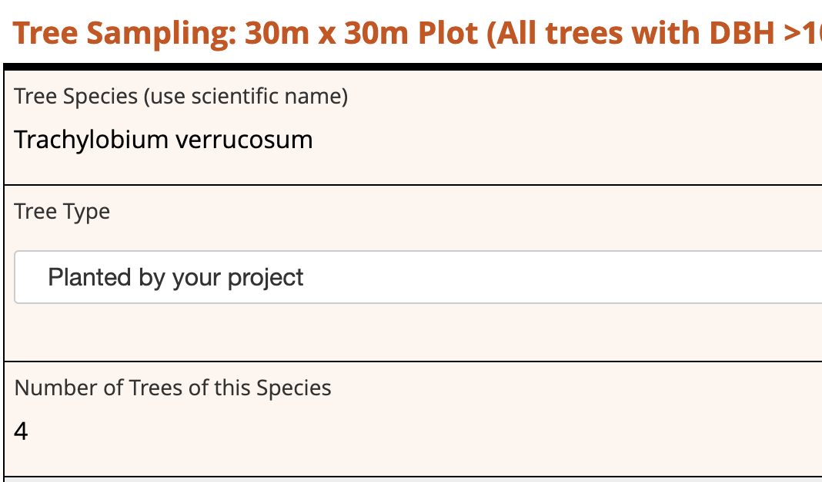
7. PLANTED trees entered in wrong sections
Record of the PLANTED trees in the 30x30 plot is either missing or planted trees are recorded in the >10cm DBH category
Good Example
Record of "Naturally Regenerating" or "Already Present" trees
Bad Example
Record of trees "Planted by your project"

Slide 36
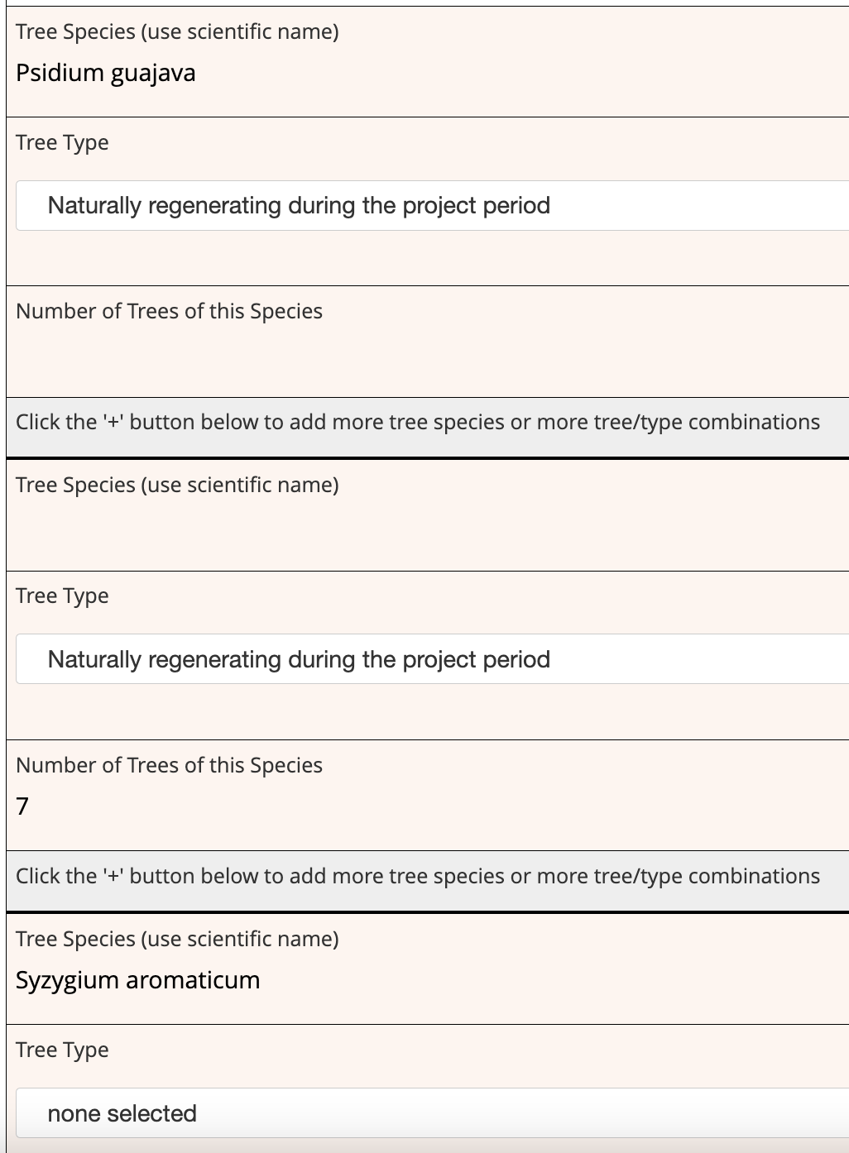
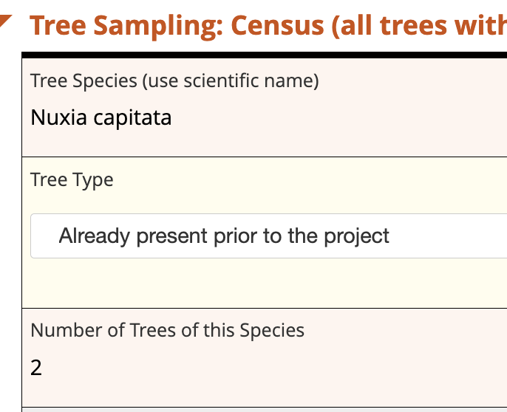
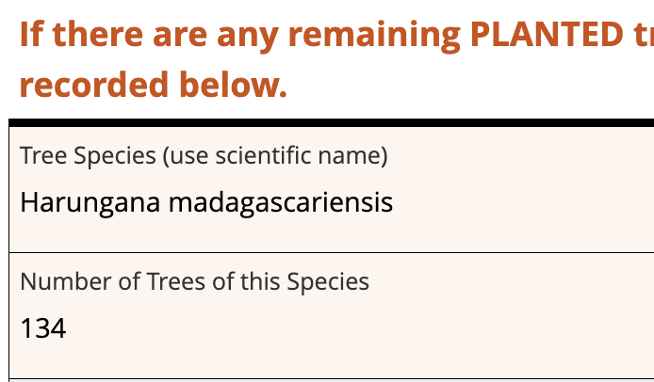
8. Missing one or more required information
The species name, or related number of trees or tree type is missing
Good Example
All required information is submitted
Bad Example
Missing one or more categories of information

Slide 37
Socioeconomic Data
Disaggregation
Workdays
Socioeconomic Restoration Partners

Slide 38
Disaggregation in Socioeconomic Data
Disaggregation by gender, age and ethnicity is required for both workdays and socioeconomic restoration partners
  If there is reason you are unable to collect some of this data (Ex: there is a law against collecting ethnicity information in your country), then you must alert the global monitoring team, and ensure agreement
For workdays, disaggregation by activity (Ex: planting, maintenance, monitoring) and paid or unpaid is required
For socioeconomic restoration partners, disaggregation by benefit type (Ex: income, increased market access, etc) is required

Slide 39
Socioeconomic Restoration Partners (SRP)
Uploaded into the IMP once a year as part of the quarter 4 reports (due in January). Data is for the whole year
Must include direct and indirect restoration partners
  Indirect restoration partners should be calculated for as many categories as applicable in your project
    Typically, indirect SRPs are calculated for the categories of income, conservation agreement payments, newly secured land titles and increased protection of traditional livelihoods at a minimum, but others may be applicable in your project
Term | Definition | Calculation Method
Direct socioeconomic restoration partners | Any person who received intentional and direct socio-economic support from PPC Program activities and is aware that they received support. Support may be monetary or non-monetary, and includes partnerships created as a direct result of the project that yields economic impacts during the project. | Direct counting of people impacted by the project. Requires record keeping throughout the year, even though only reported once per year
Indirect socioeconomic restoration partners | Family members of direct partners, and persons with involvement with local organizations and partnerships that may bring jobs in the future | Method can be tailored to project context. If a more precise approach does not exist, the average household size can be used

Slide 40
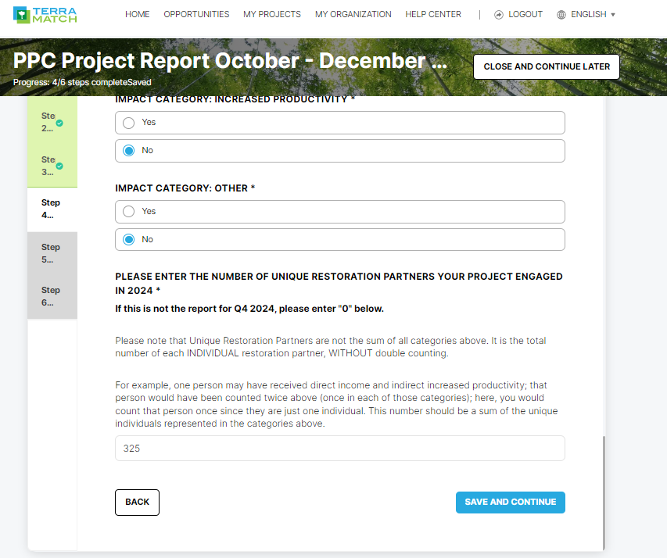
Socioeconomic Restoration Partners (SRP)
We calculate two totals:
1. Overall Total: A simple sum of each category, which may include double counting of the same people in multiple benefit categories - You don't need to enter the total value on the IMP. This will be calculated by the system automatically
2. Total Unique: A sum that doesn't include double counting, so each restoration partner is only counted once
- For example, 2 SAME people who receive 3 forms of benefits means that Total = 6, Total Unique =2

Slide 41
Discussion
Any questions or concerns?
Follow up training needed?

